Slide 1
Energy Consumption
Forecasting with Time Series Data
MIS-776 Business Intelligence
Dr. Michael Lee
Jun Hee Lee, Nirupama Mohan, Mai Pham, Idalia Valdez

Slide 2
Presentation Content
Address the Business Question
Dataset Overview
Techniques Applied
Result
Future Improvements

Slide 3
Business Objectives
Create energy consumption forecast
Meet future demand without running the risk of blackouts and consumers’ dissatisfaction
Maximize utilization of power generating plants
Help planning for maintenance of the power systems
Get accurate demand predictions to help creating price strategy

Slide 4
Dataset Overview
Energy consumption csv file downloaded from Kaggle
Contains 4 years of hourly data on electrical consumption, generation, pricing for Spain
Retrieved from ENTSOE, a Spanish public portal for Transmission Service Operator (TSO) data
Time series - collected daily by the hour
Data was split into two sets:
Train Data: Total Load Actual From January 2015 - December 2017
Test Data: Total Load Actual From January 2018 - December 2018

Slide 5
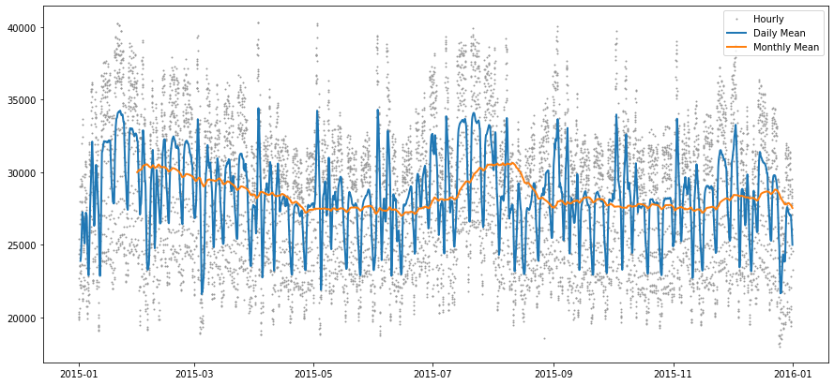
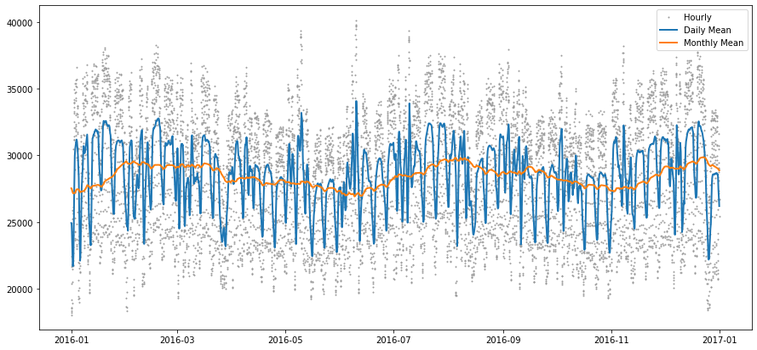
YEARLY PLOTS FOR 2015 - 2016

Slide 6
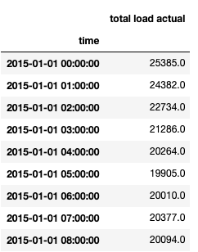
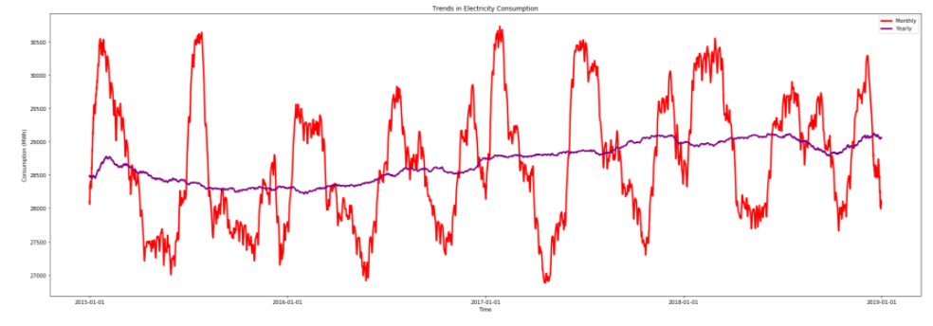
Data Cleaning and Preprocessing
Removal of unnecessary columns
Removal of duplicate data
Filling missing data using forward filling - demand at a given hour is almost same as the previous hour
Descriptive statistics
Application of Dickey-Fuller test to discover if data set was stationary

Slide 7
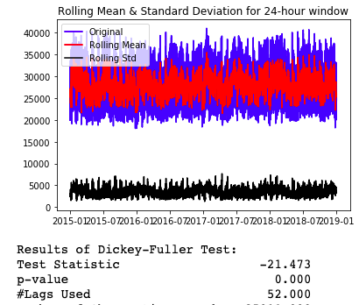
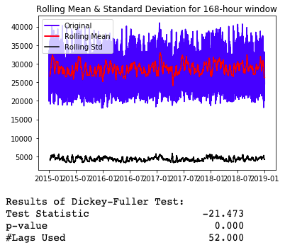
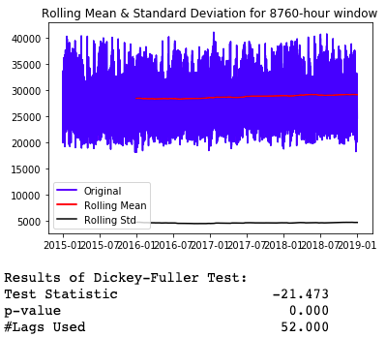
Data Insights: Stationarity Check

Slide 8
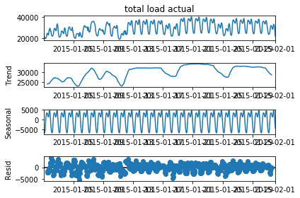
Data Insights: Seasonalities
No trend on dataset however, multiple seasonalities were detected
Highest energy consumption of the week is observed during weekdays
Energy consumption is highest during business hours
Energy demand fluctuations were detected, Winter and Summer months having a higher demand and Spring months the lowest
These evaluations indicate the presence of other potential influential features to the demand beyond the ones that have been applied in this project

Slide 9
Data Modelling Techniques
Regression models: Linear regression, KNN, and Random Forests
Linear Regression: No autocorrelation is needed for this type of models; if present results will be biased, inconsistent, and inefficient. Since the dataset is time series, we cannot assume no autocorrelation between the lagged terms
Random Forest: Prediction is overfit, and model does not scale well with presence of seasonality and trend
Time series models:
ARMA: Failed to address multi-seasonalities
Seasonal-ARIMA, TBATS: Successfully address multi-seasonalities, but predictions have large errors
Chosen Model: Prophet
Successfully address multi-seasonalities, simultaneously make use of Fourier Series to fit the seasonal relationships in data
Better predictions with results including upper and lower predicted consumption within 95% confidence intervals

Slide 10
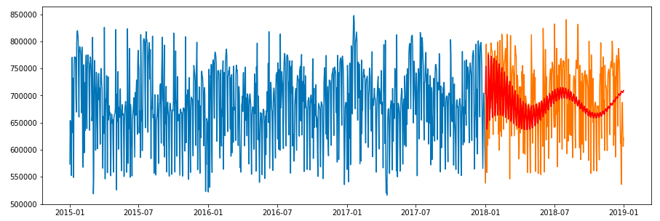
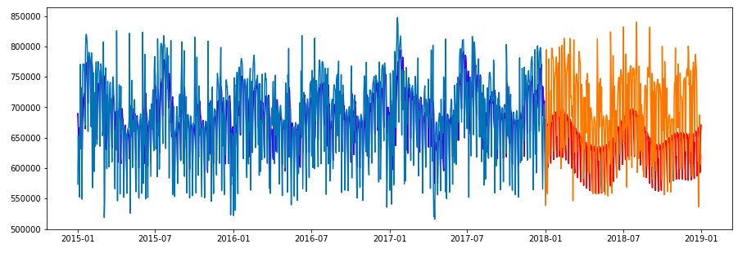
Results with SARIMA and TBATS
SARIMA
TBATS

Slide 11
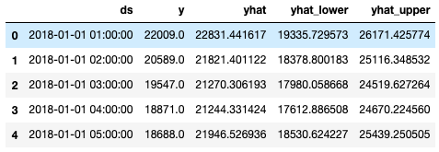
Prophet Model
Package by Facebook - used to analyse time series dataset - sales forecast, capacity planning etc
Sum of trend, seasonality and holiday effects
Takes into account multiple seasonalities
Easy and completely automatic
NA values are handled automatically
Default settings produce accurate results
Created an additive model - magnitude of seasonal variation is same
Model improved using hyperparameter tuning

Slide 12
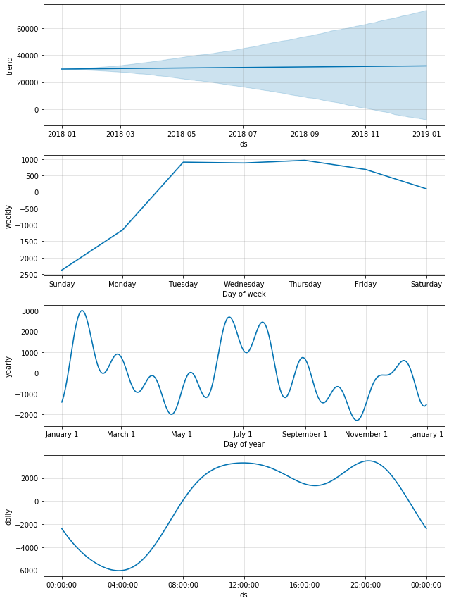
Prophet Results
Detects seasonalities automatically
Plots component function provides the trend and seasonalities of the model - clearly shows the demand peaks in summer and winter
Provides prediction values for lower and upper bound for demand, yearly min-max values, trend upper and lower, among others

Slide 13
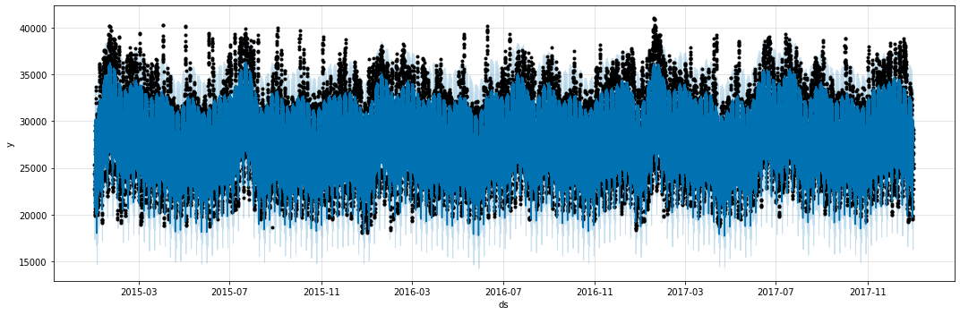
PROPHET RESULTS FOR TRAINING DATA

Slide 14
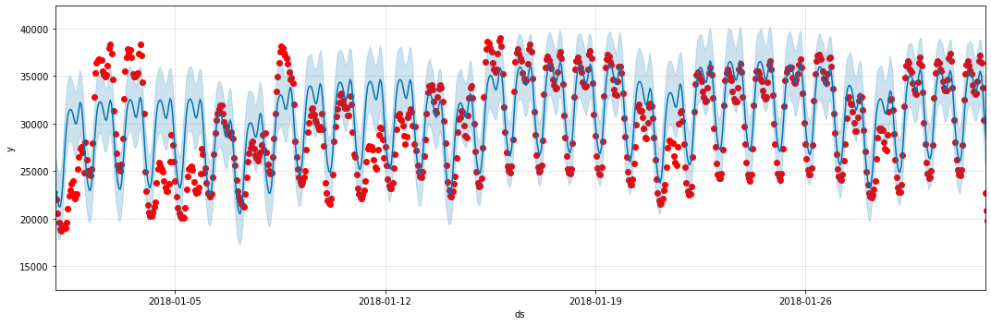
Red dots - actual demand
Blue line- predicted demand
Light blue - 95% Confidence interval for prediction

Slide 15
Prophet Model in Comparison With Other Models
Simple Model: an intuitive model calculating hourly demand based on weekly averages of same hour in same week last year
Metric | Simple Model | Prophet | Random Forest | TBATS
Mean Absolute Error | 2286.03 | 1901.64 | 484.83 | 41107.57
Mean Squared Error | 8253364.56 | 6692754.85 | 510526.11 | 3188007525.50
R-squared | 0.61 | 0.68 | 0.98 | 0.27

Slide 16
Conclusion
Data set is time series format. Therefore, the regression models would not offer a reliable forecast
Prophet model offers the best results compared to other time series models
Prophet offers a prediction number and a confidence interval that company executives can use, as they make decisions for the company overall planning
The forecast can serve as the basis for budget, production, maintenance, and resources planning
Pricing strategies can be planned with the forecast derived as the basis
Model is not final, there is plenty of room for improvement using other features that might be correlated with energy consumption and that would need to be discovered through more analysis

Slide 17

Thank you for listening!

